Slide 1

Securing the Cloud: AI-Powered Container Security
The growing threat landscape for cloud-based containers.
Introducing a next-generation security system for modern containerized environments.
Key features: AI-powered scanning, real-time monitoring, DevSecOps integration.
Rohith Roshan 23BAI1415
Lalithya krishn 23BEC1042
YatinKrishna 23BEC1240
Suganthakrishnan 23BEC1144
Hari Prasad R 23MIS1128

Slide 2
AI-Powered Vulnerability Scanning
Dynamic scanning
Zero-day exploits
Traditional scanning limitations in dynamic container environments.
AI algorithms identify zero-day exploits and emerging threats.
Continuous learning and adaptation to new container images and configurations.

Slide 3
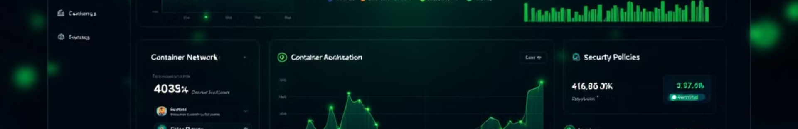



Real-time Threat Monitoring & Automated Security Policies
Continuous Monitoring
Of container behavior and network traffic.
Automated Policies
Based on industry best practices and compliance standards.
Real-time Alerts
Automated responses to suspicious activities.

Slide 4




DevSecOps Integration for Secure Deployment
Seamless Integration
With CI/CD pipelines and development workflows.
Automated Checks
Security checks throughout the lifecycle.
Collaboration
Between teams.

Slide 5




AI-Driven Anomaly Detection
Baseline Behavior
Detect Deviations
Using machine learning.
From normal behavior.
Proactive Detection
Of anomalous patterns.

Slide 6
Automated Patching and Compliance Tracking
Identify Patches
1
Automatically for vulnerable containers.
Ensure Updates
2
With the latest security updates.
Generate Reports
3
Demonstrate adherence to standards.

Slide 7

Benefits and ROI
90%
50%
Reduced Risk
Improved Security
Of breaches and data loss.
Posture and compliance.
30%
Increased Efficiency
For development and operations.

Slide 8

Conclusion: Secure Your Cloud Future
Summary of key features and benefits.
Call to action: Request a demo or start a free trial.
Emphasize proactive container security.
Don't wait for the breach; secure your containers today!

